Slide 1
Parent Meeting
Listening to your child read
Notes:
Approximately 20 minutes is needed for this session.
Notes are provided to help you lead the presentation.
Notes in italics are for your attention only.
Provide copies of ‘Reading at Home Booklet 1 or 2’ from Oxford Owl.
Booklet 1 is for Set 1 sound groups and Ditty/ Red Groups and Booklet 2 for Green – Grey Storybooks.
Children will make the best possible progress if they read as often as possible.
Today we are going to discuss how to listen to your child read their Read Write Inc. Phonics decodable storybook when they bring it home.

Slide 2
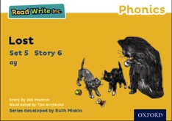
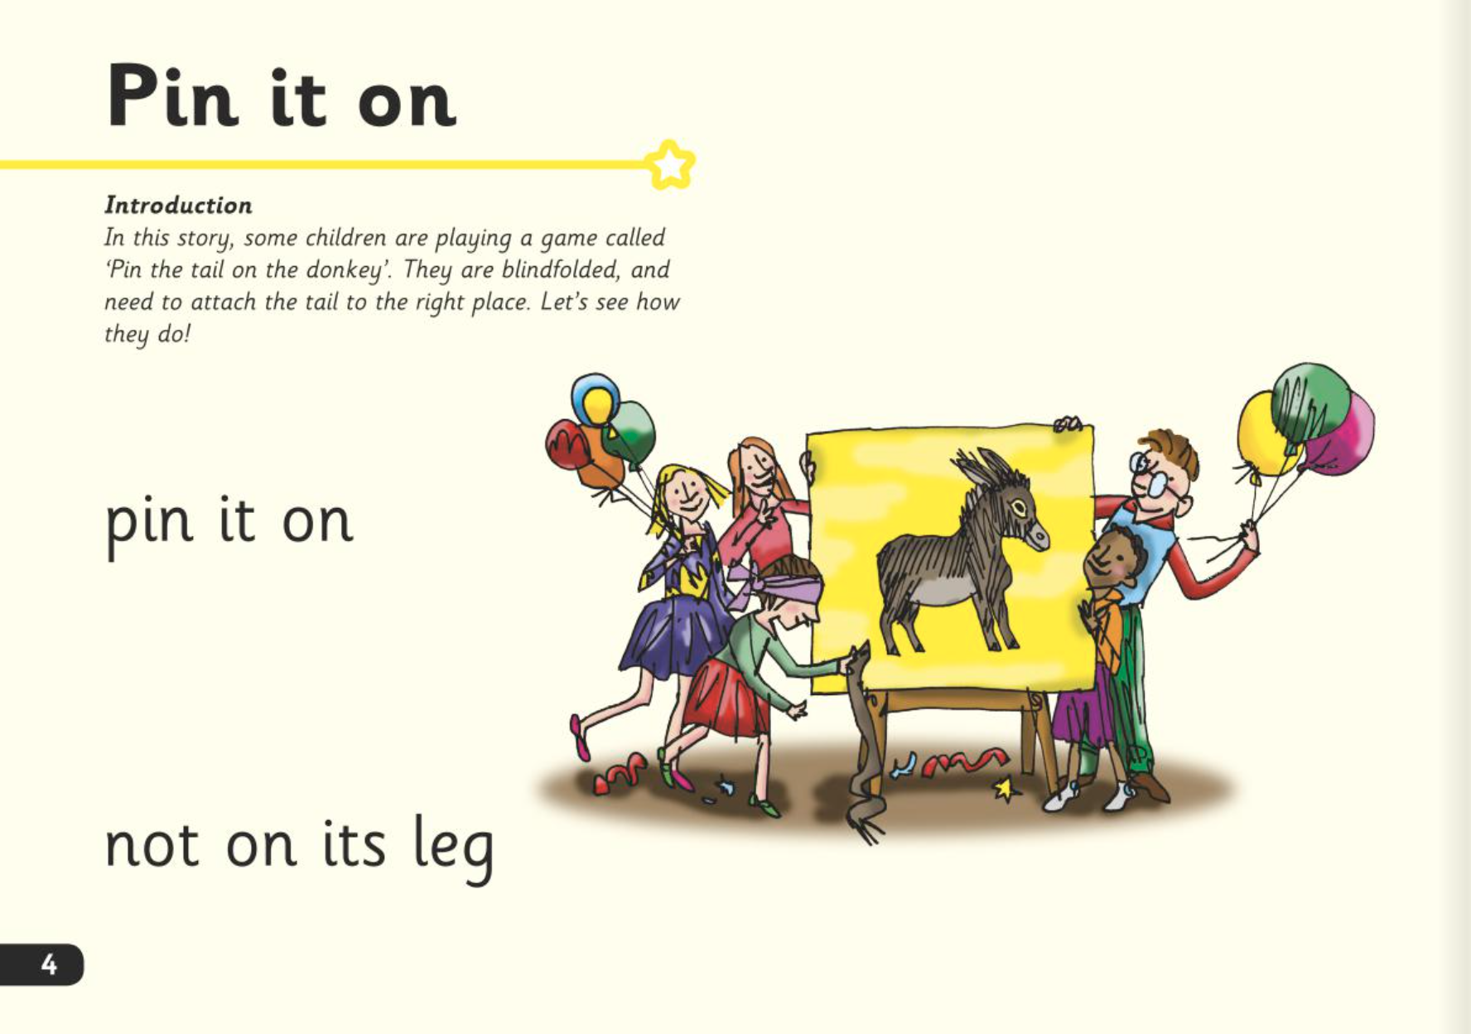
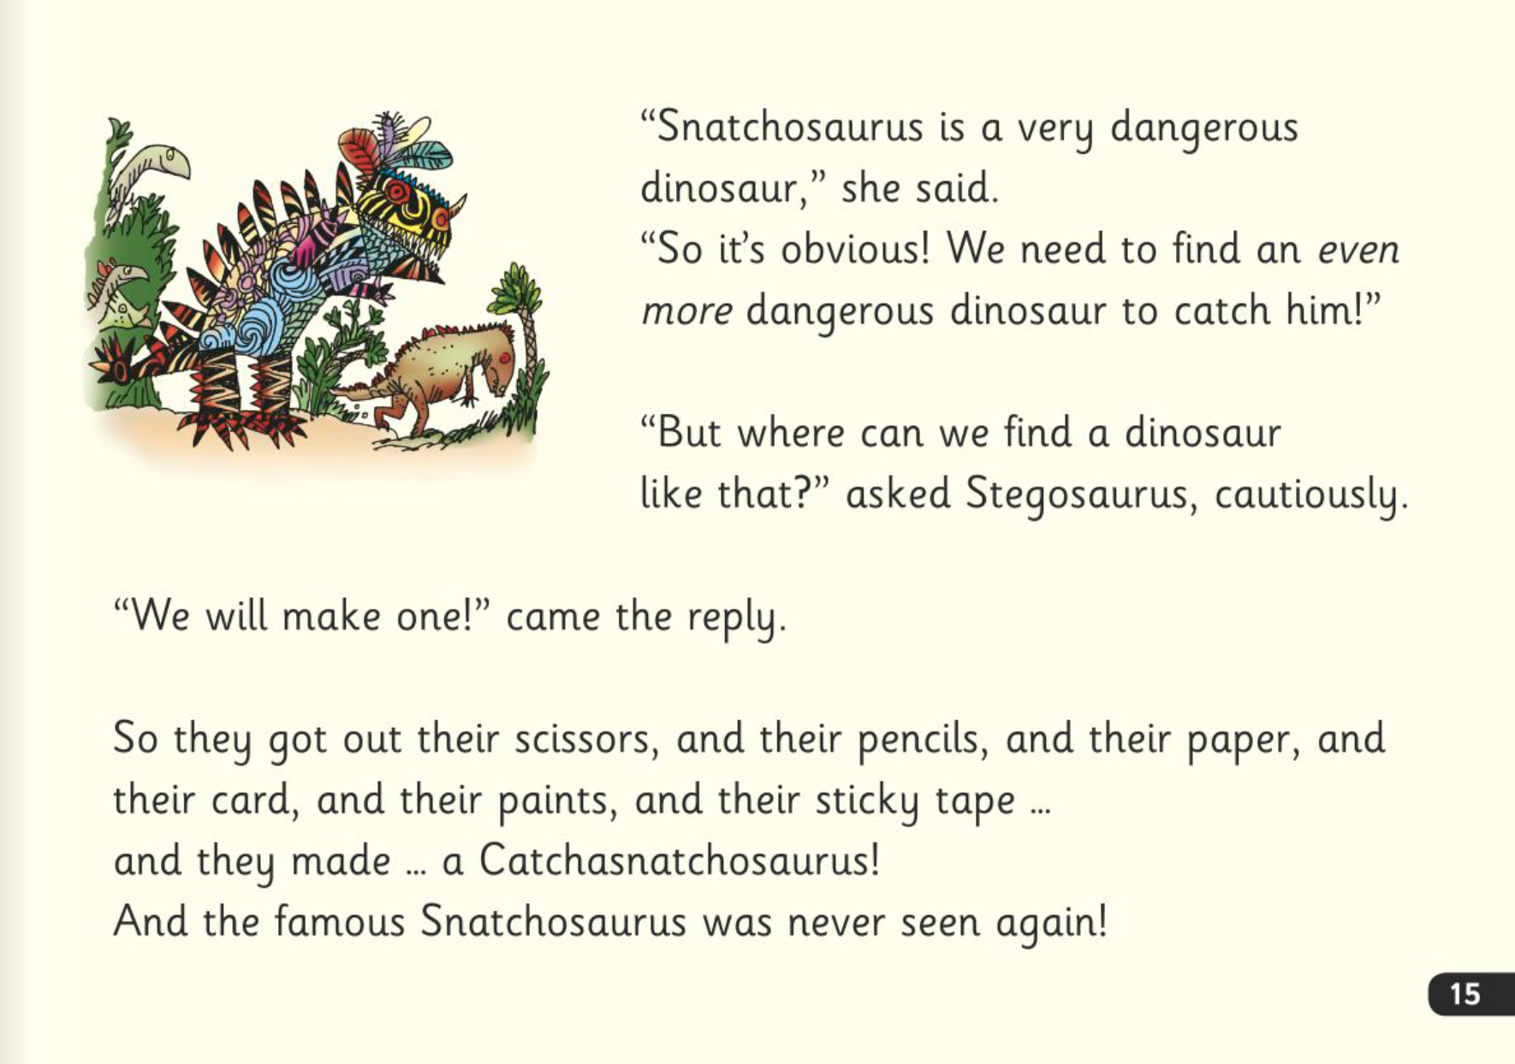
Read Write Inc. Storybooks
Notes:
In our school, children read Read Write Inc. Storybooks that match the sounds they can read.

Slide 3
Three reads
Accuracy
Fluency
Comprehension
Notes:
They read each Read Write Inc. Storybook three times in class with their partner.
Re-reading the same book helps children to become confident readers. Each time they re-read, they build their fluency/speed and comprehension.
They love reading and want to read because they can read all of the words in the Storybook.
We set a focus for each re-read in school.
(Click) The first read focuses on reading every word accurately.
(Click) The second on reading the story more quickly.
(Click) The third read on comprehension - understanding what they read. Children can only do this once they can read all of the words accurately and read at a sufficient pace.

Slide 4

After the third read…
Notes:
So after the third read in class, children bring the same Storybook home to read and enjoy with you at home.
They love this book!
They can’t wait to read it to you, their grandparents or even their teddy bear.
With a little more practice at home, they will soon be able to show off their storyteller voice to the family!
Our school sends home books that match the sounds your child can read. We will never expect your child to read a book that contains sounds they cannot read.
We want them to be set up to succeed in their reading.
We want to make sure they enjoy reading so that they want to read.
The more they read, the faster progress they will make.
Please avoid saying, “This book is too easy for you!” but instead say “I love how well you can read this book!”

Slide 5

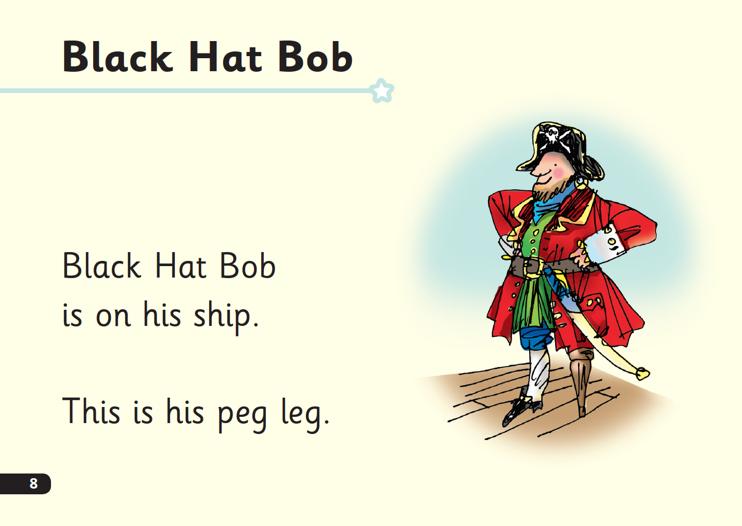
‘Special Friends’, ‘Fred Talk’
Notes:
Children will be able to read all of the words in the Storybook.
If they hesitate, remind them to read the word using ‘Special Friends, Fred Talk,’.
For example, this means they spot the ‘sh’, then Fred Talk and blend to read the word e.g. sh, sh-i-p, ship.

Slide 6

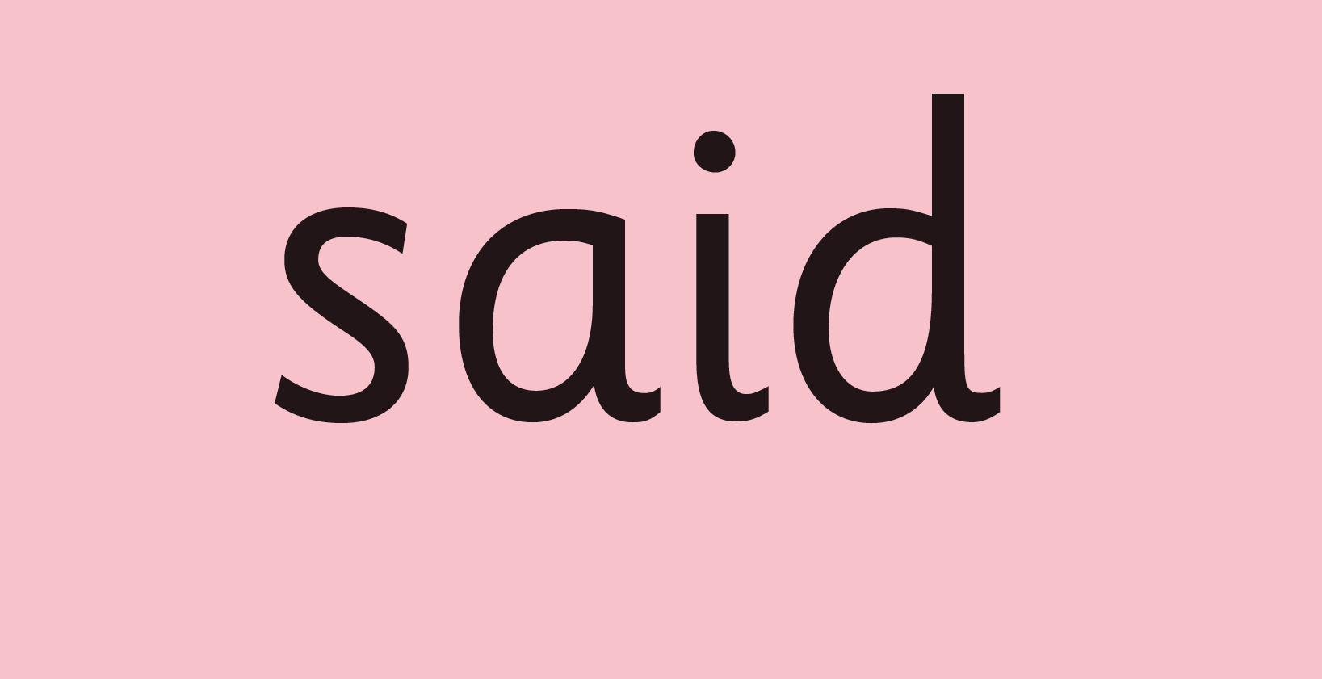
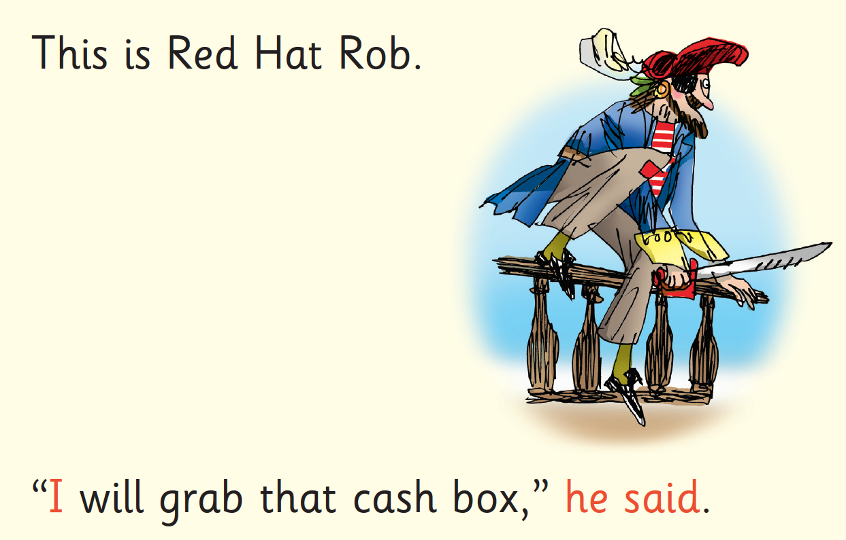
Red Words
Notes:
Some words are ‘tricky’ because they contain letters that don’t match the sounds the child has been taught.
For example, ‘said’ has ‘ai’ making an ‘e’ sound.
We teach these common exception words as Red words.
In the early Storybooks, these words are printed in red text.
Remind your child not to use Fred Talk to read Red words but instead to stop and think. Tell them the word if needed.

Slide 7
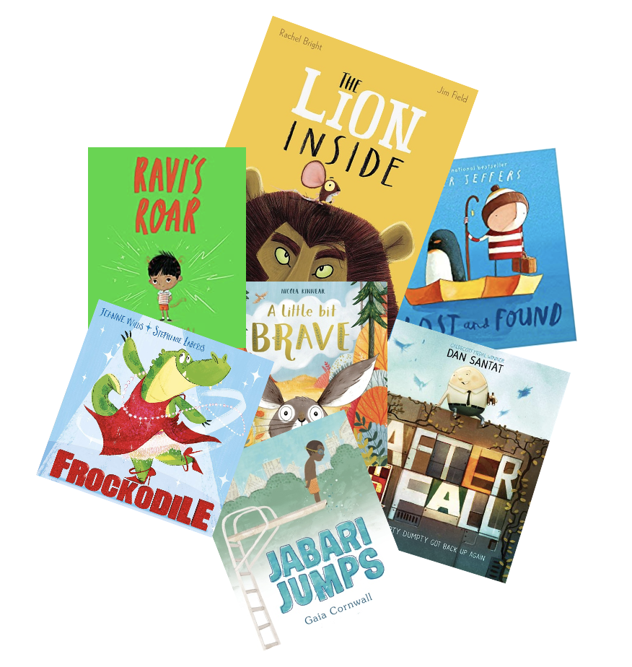
Which books will children bring home?
+
+
+
Notes:
In your child’s book bag, they will bring home:
- the Storybook they have just read in class to practise reading what they can already read.
- if applicable a ‘Last and past’ Storybook – a previously read RWI Storybooks for extra practice. The children enjoy re-reading stories they know well. Their fluency improves on every reading.
- if applicable a Book Bag Book. I’ll explain more about these in one moment.
A picture book to share with you which has already been read to them so they care about it. You can read the story to them or they can retell the story by looking at the pictures. They are not expected to read the story themselves.
We make sure that every book that goes into your child’s book bag is a well-loved book – one they know already and want to read again and again.

Slide 8
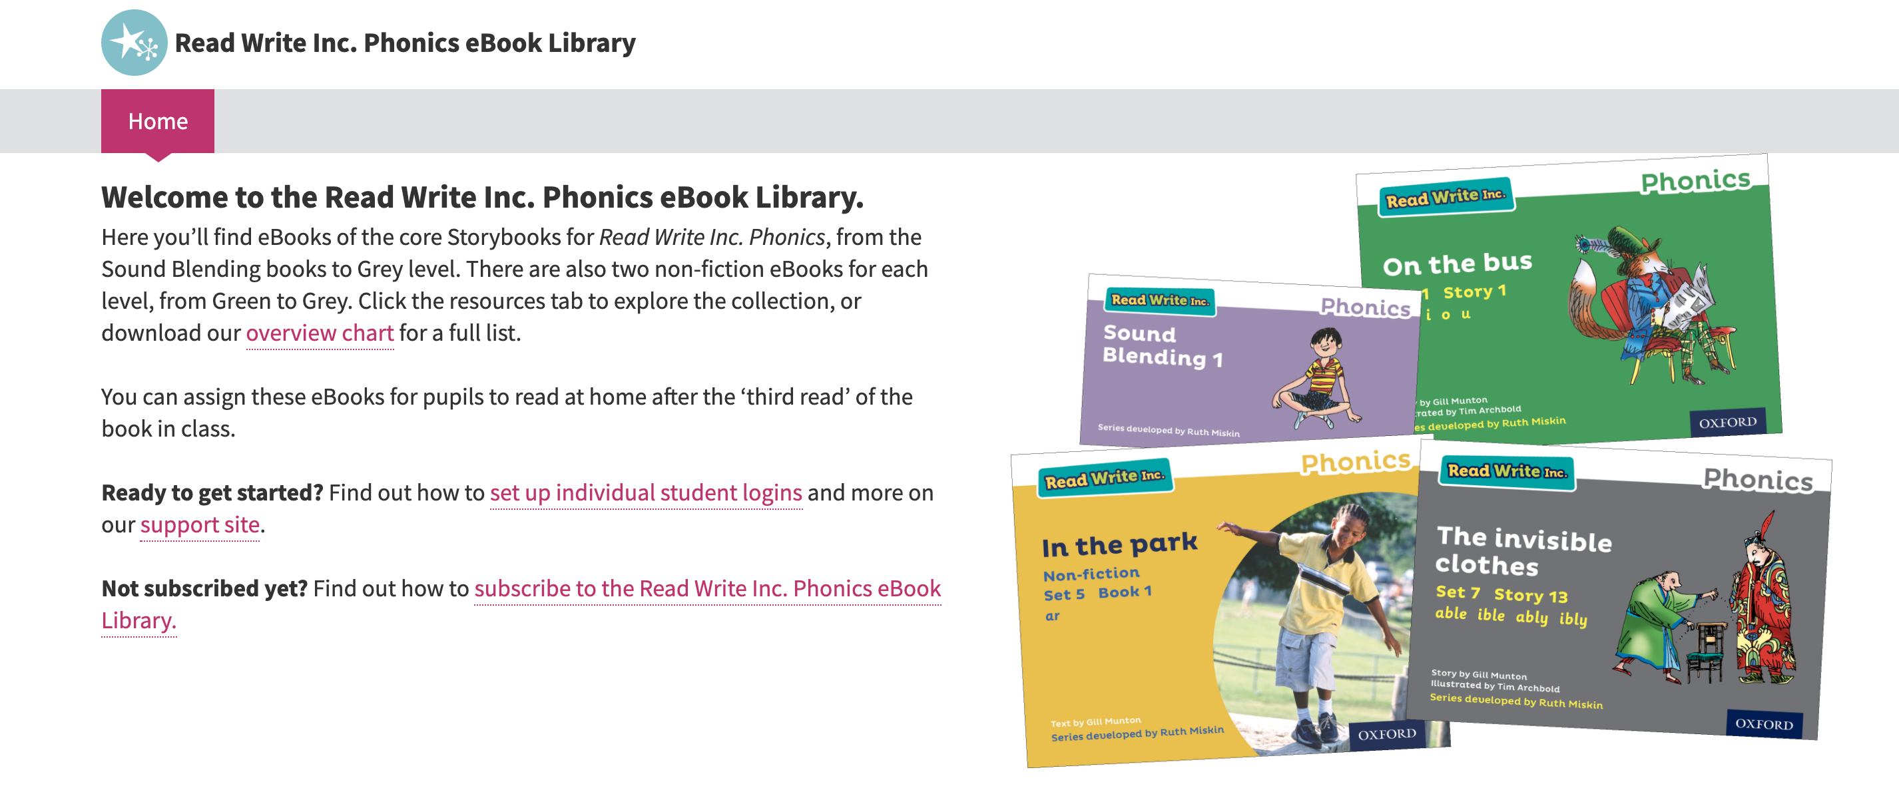
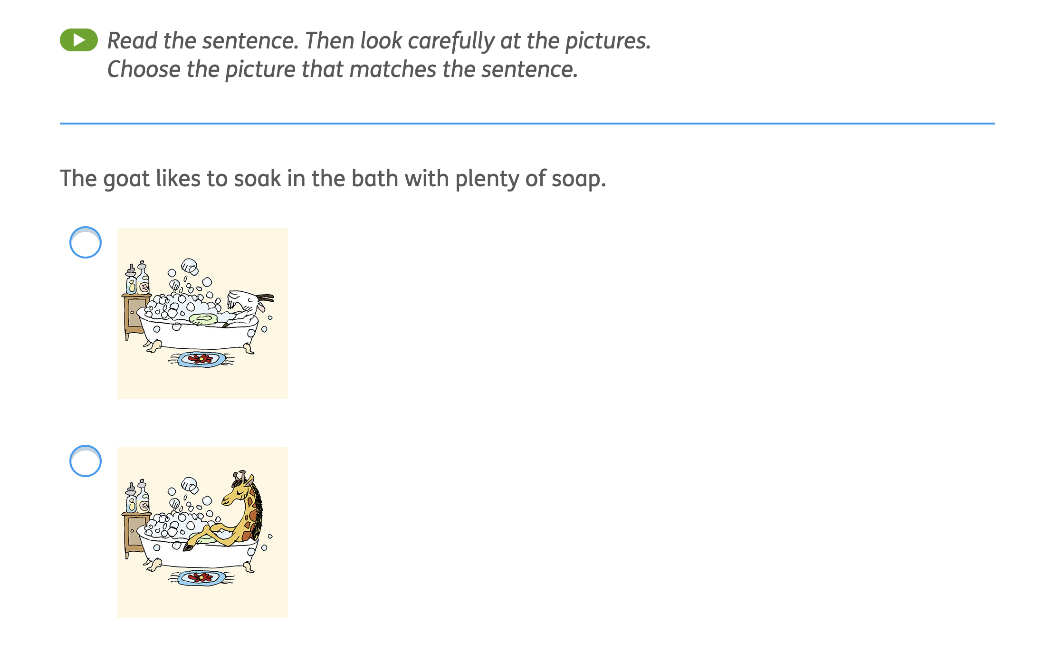
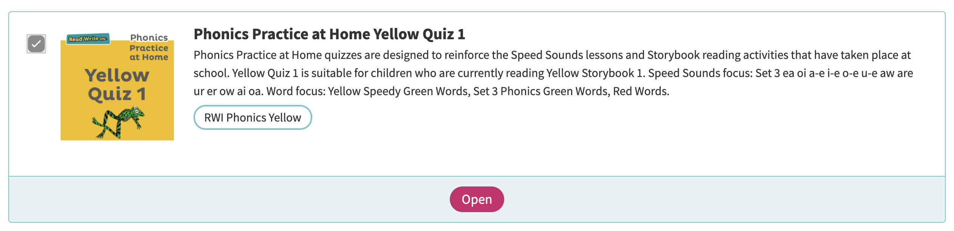
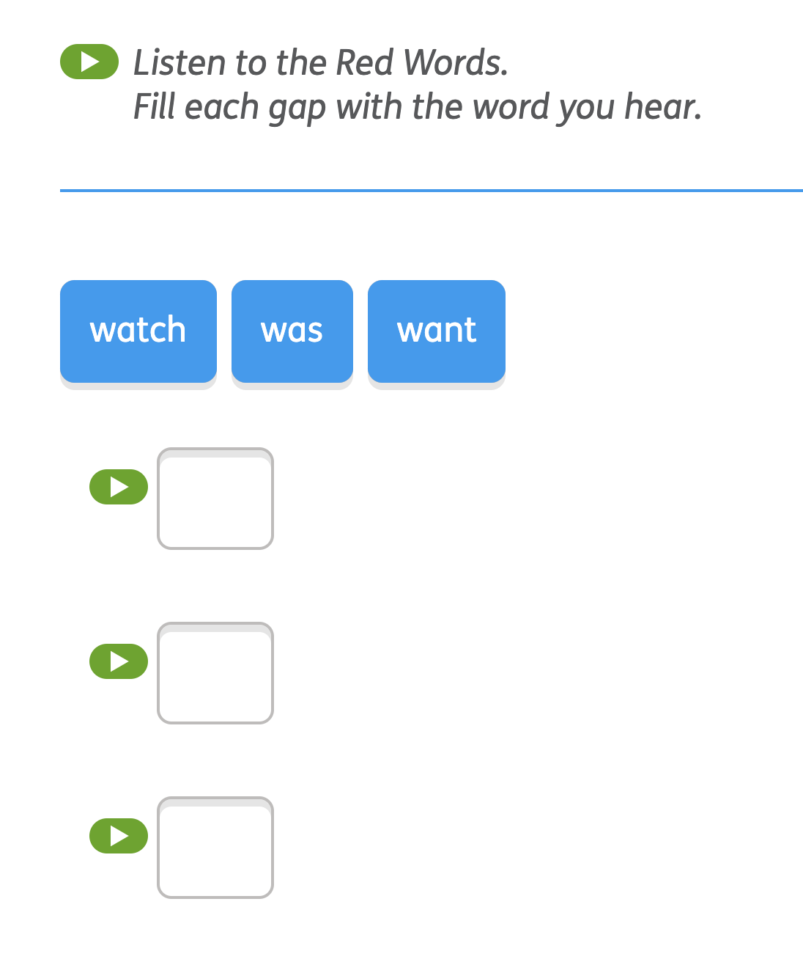
RWI Phonics e-Book subscription
Notes:
Use slide if appliable.
We also use the Read Write Inc. Phonics eBook Library Subscription.
Each week, we will assign your child the book they have read during the week to read on a tablet or other device.
There are also phonics practice games to match each book.

Slide 9

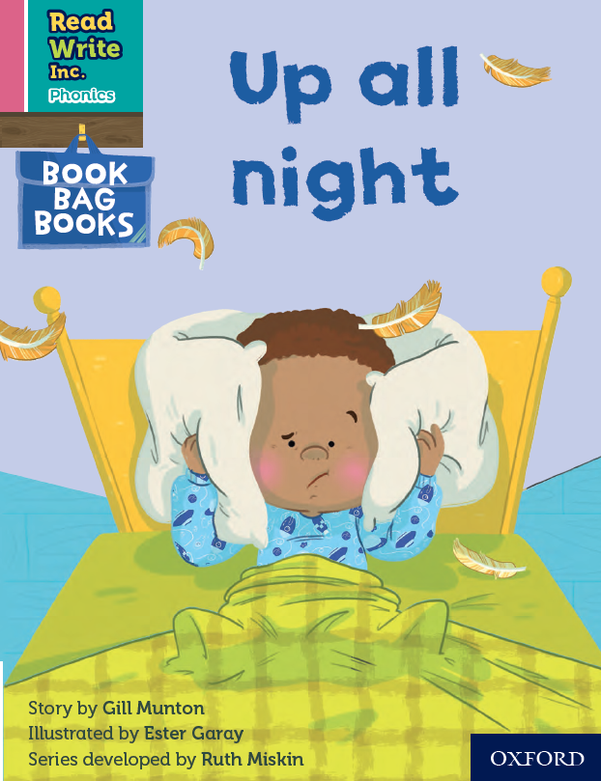
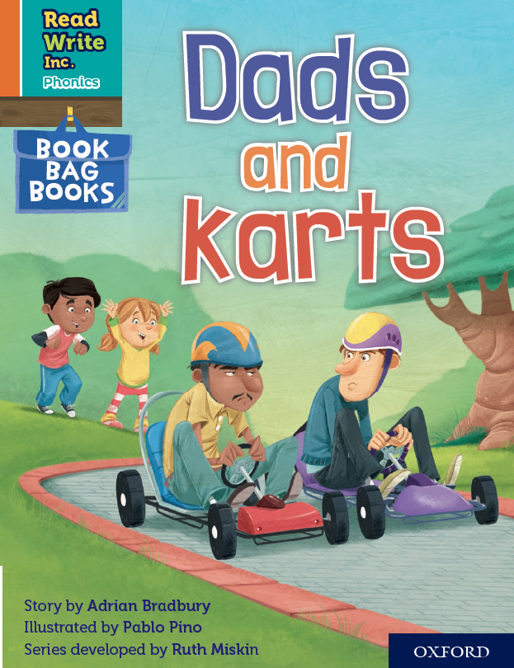

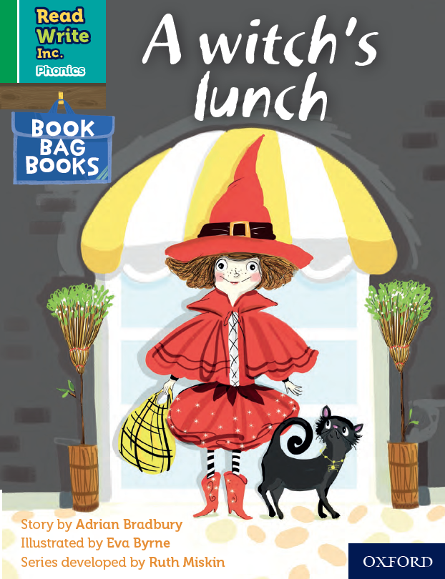
Book Bag Books
Extra reading practice at home.
Linked to the story they have read in class.
Matched to the sounds children know.
Notes:
Only use this slide if you use Book Bag Books in your school.
We use Book Bag Books especially for extra reading practice at home. They have guidance inside just for you, as parents.
These stories link to the story they have read in class.
They are matched to the books children read in school so provide practice of the same sounds. Your child will not have read this book before, but they know all the sounds and will be able to work out any new words.

Slide 10
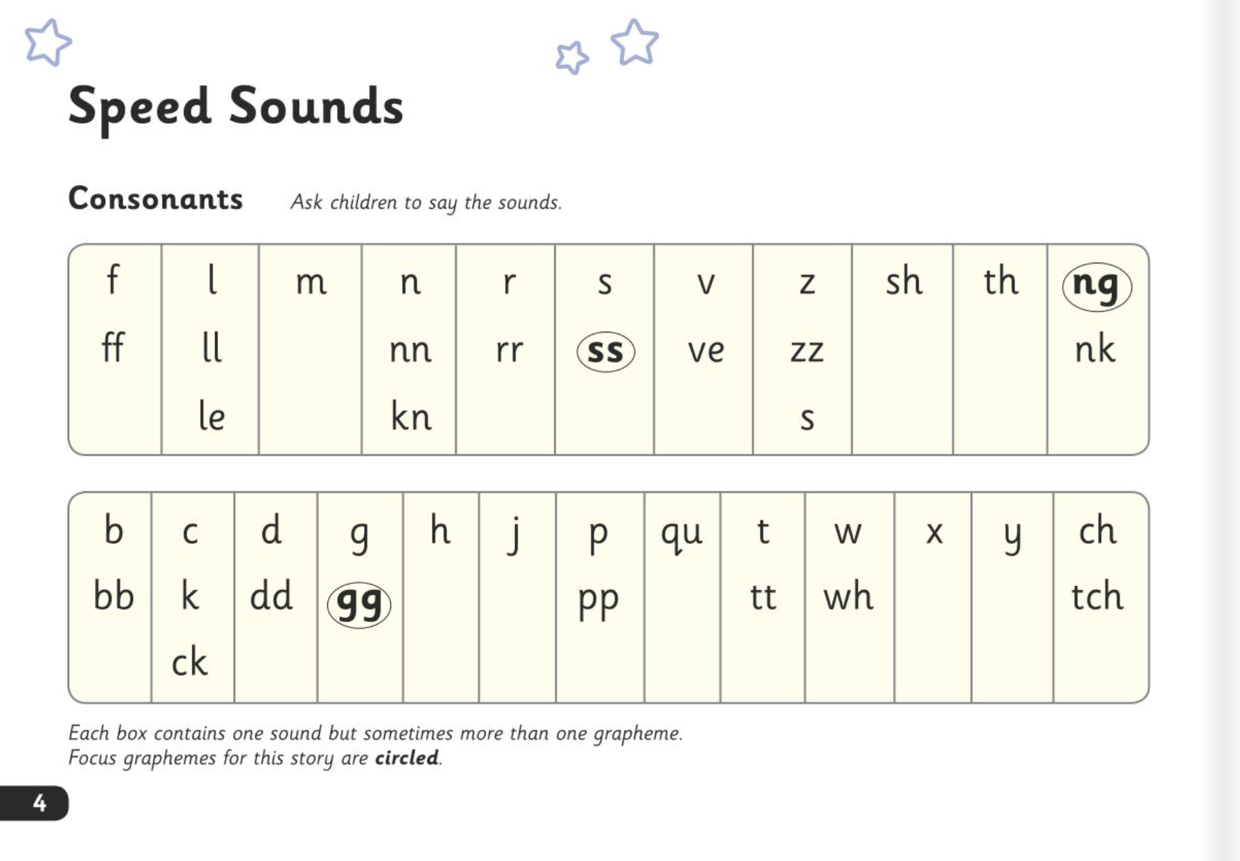
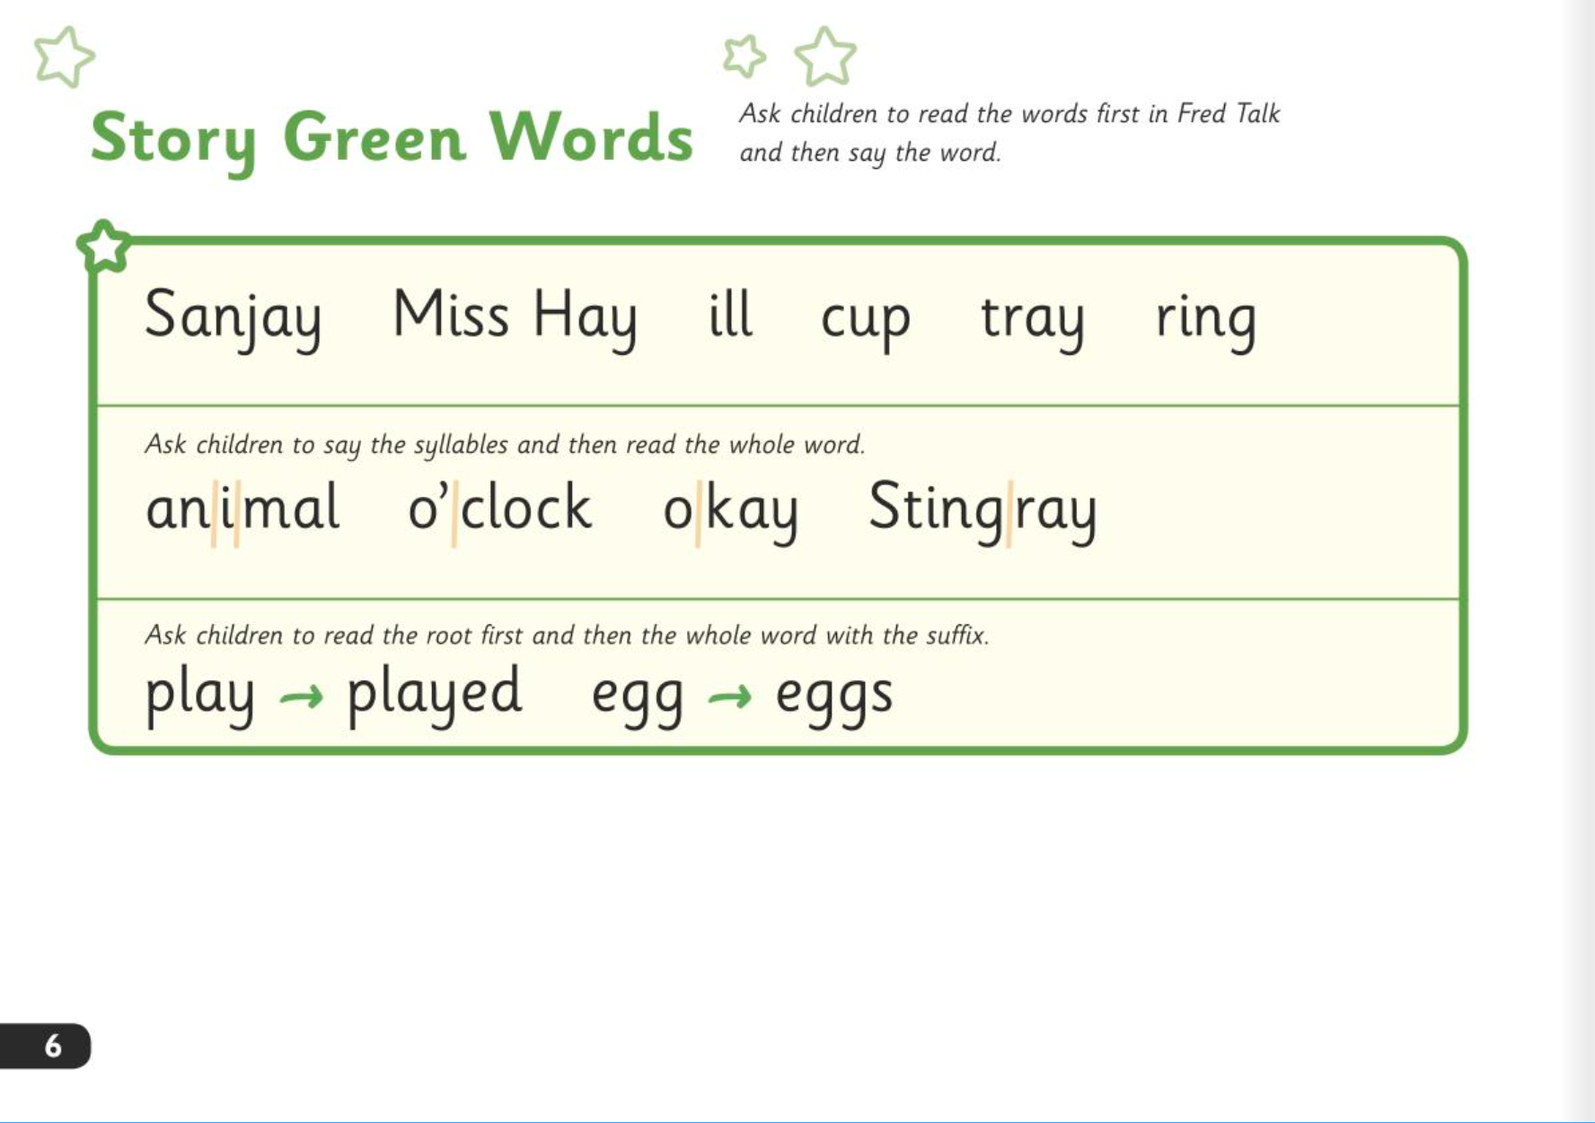
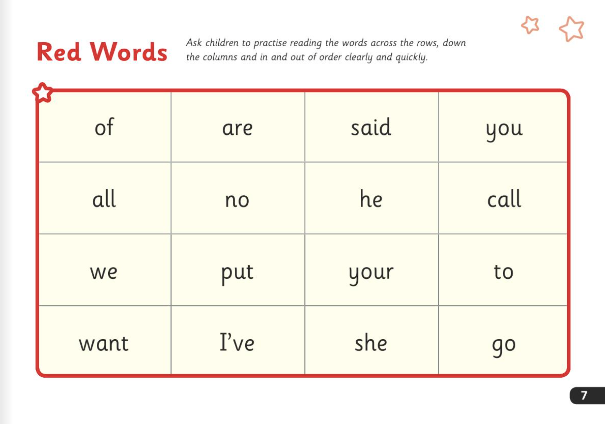
What can I do?
Ask your child to read the sounds and words before they read the story.
They will enjoy teaching you to read these words too.
Notes:
Ask your child to read the sounds and words before they read the story. These are at the front of the book.
They will enjoy teaching you to read these words too.

Slide 11
What can I do?
When your child reads the story, encourage them to read the word in Fred Talk if they hesitate or read it incorrectly.
Praise them when they succeed.
Notes:
When your child reads the story, encourage them to read the word in Fred Talk if they hesitate or read it incorrectly. Praise them when they succeed.

Slide 12
What can I do?
Read back each sentence or page to keep the plot moving.
Your child’s energy is going into reading the words not the story.
Notes:
Read back each sentence or page to keep the plot moving - your child’s energy is going into reading the words not the story.

Slide 13
What can I do?
Avoid reading the story to them first.
Avoid asking your child to guess a word by looking the pictures.
Try not to become irritable if your child ever struggles!
Keep smiling!

Slide 14
Online resources available
Ruth Miskin Parents’ Page:
https://www.ruthmiskin.com/parents/
Ruth Miskin Facebook:
https://www.facebook.com/miskin.education
Free e-books for home reading:
http://www.oxfordowl.co.uk/Reading/

Slide 15
The more that you read, the more things you will know. The more that you learn, the more places you’ll go!
Dr. Seuss
Notes:
In the words of Dr Seuss…read quote.
Good readers do well in school – and in life.
By listening to your child read, you are making sure they have the opportunity to practise and become a good reader quickly.
Remember that all parents have the power to change outcomes for their children.

Slide 16

Any questions?

